Slide 1
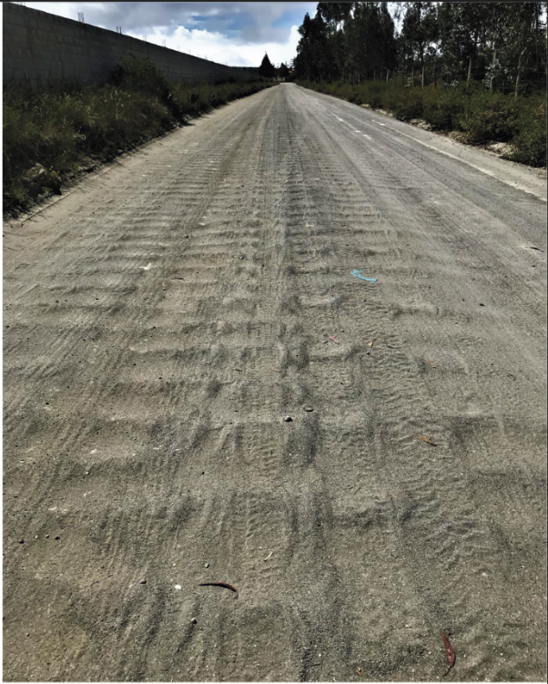
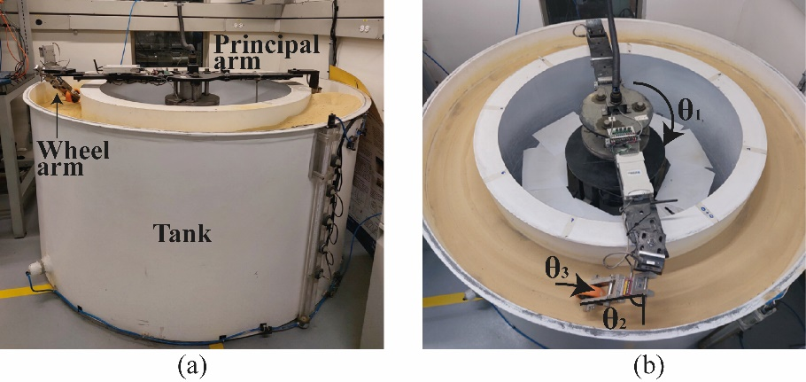
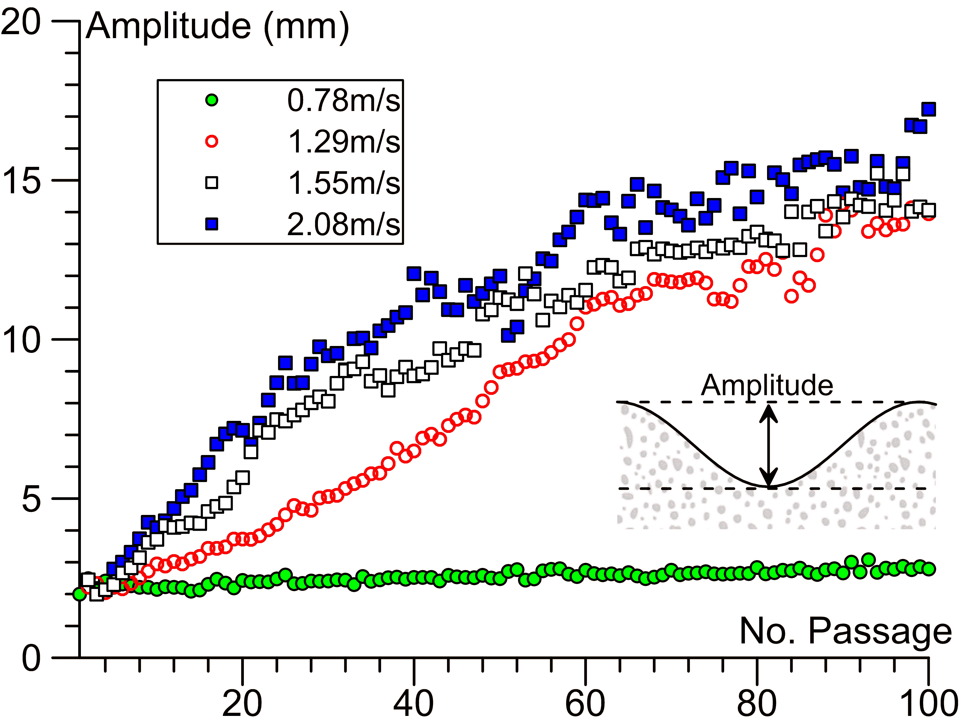
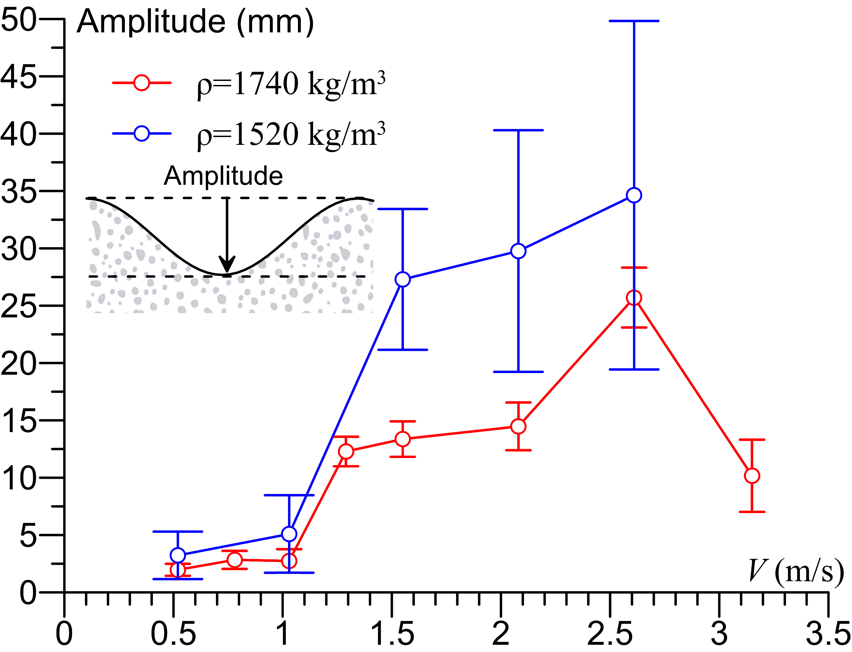
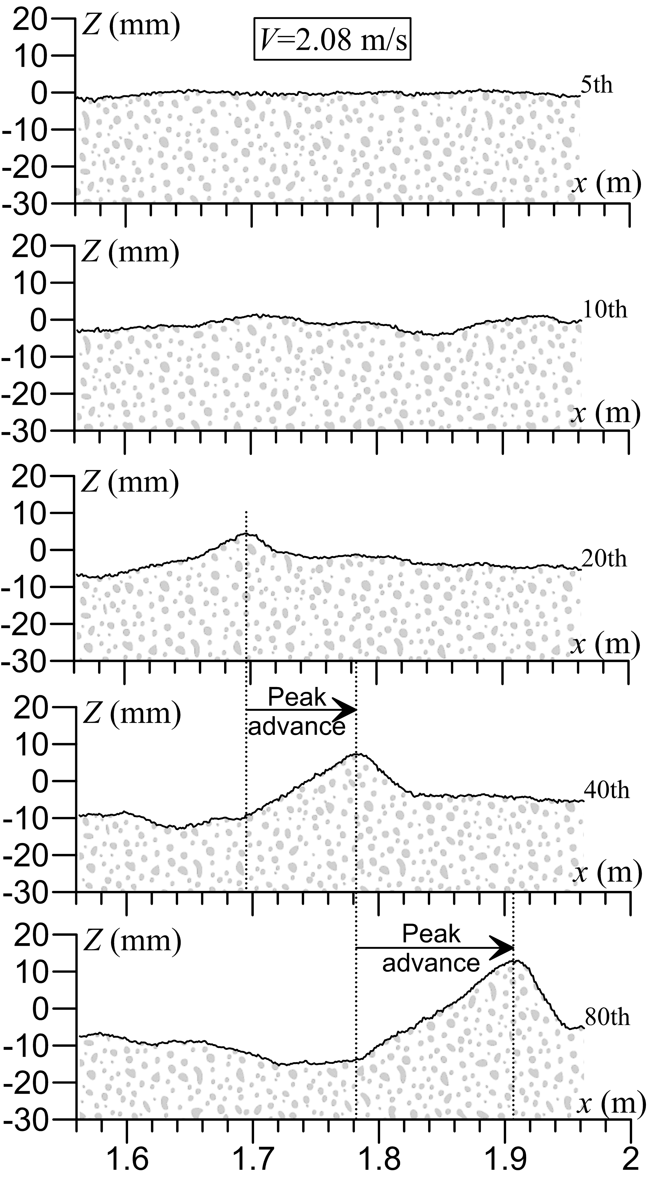
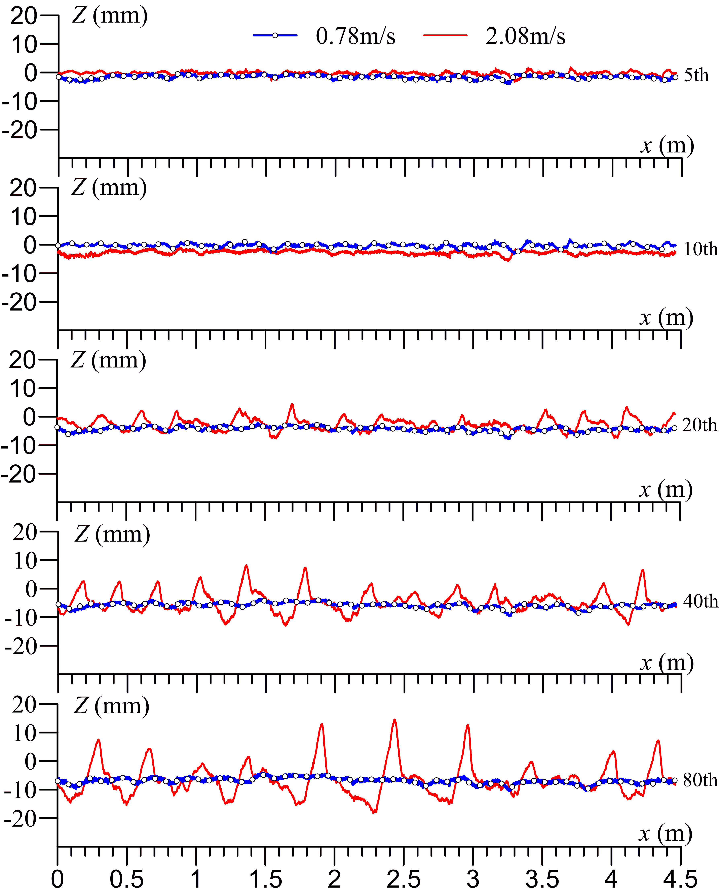
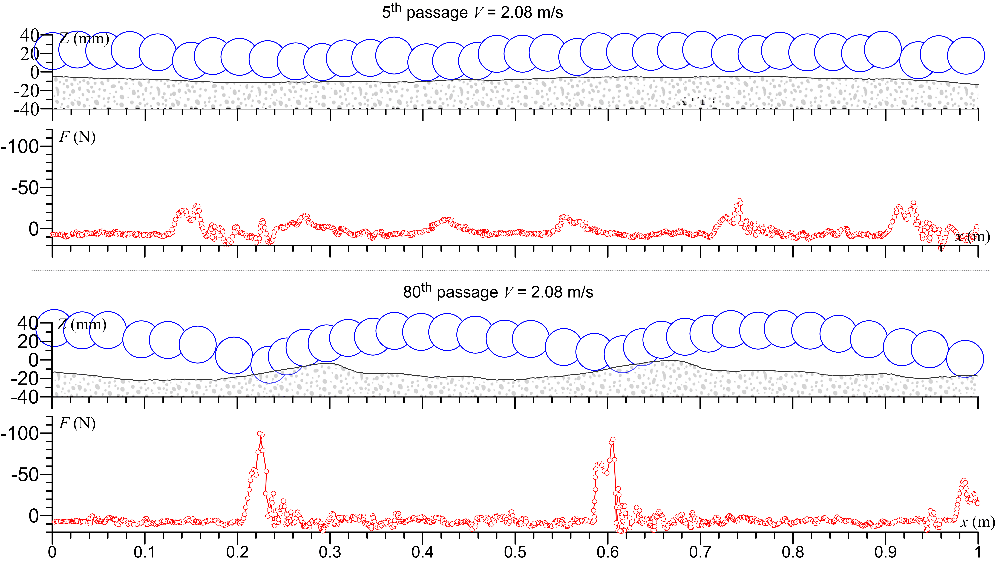


Experimental Modelling of Washboard Phenomenon in Unpaved Roads
María José Torres ¹, Bernardo Caicedo ², Pablo Alvarado ¹, Laura Ibagon ^{1,2}, Fabricio Yépez ¹
¹ Colegio de Ciencias e Ingenierías, Universidad San Francisco de Quito Interoceánica y Diego de Robles, Quito, Ecuador.
² Universidad de los Andes, Cr. 1 #18a, Bogotá, Colombia
BACKGROUND
The washboard phenomenon, characterized by the presence of ripples on unpaved roads, emerges as vehicles traverse surfaces composed of sand, gravel, or mud. These undulating patterns not only cause discomfort but also pose potential hazards to drivers by disrupting tire-road contact. Despite its significance, limited research has been conducted on ripple phenomena, and the primary cause of their formation remains uncertain. This study aims to unravel some mechanisms of these patterns by analyzing key factors such as vehicle speed, weight, and granular material properties. The research was conducted with an experimental model set up that was constructed with rotating wheels evaluating physical variables.
METHODS
Experimental Model Set Up
Conducted Experiments
Wheel velocity (m/s)
 |  | 0.52 | 0.78 | 1.03 | 1.29 | 1.55 | 2.08 | 2.61 | 3.15
Soil density (kg/m³) | 1520 | x |  | x |  | x |  | x
 | 1740 | x | x | x | x | x | x | x | x
Wheel mass (g) | 1200 |  |  |  |  |  | x
 | 1331 |  |  |  |  |  | x
 | 1475 |  |  |  |  |  | x
RESULTS
DISCUSSION
Average Amplitude
Ripple formation is highly dependent on vehicle speed, allowing for Critical Speed Identification.
Heavier vehicles promotes ripple growth, especially at speeds exceeding the critical threshold showing vehicle Mass importance.
Soil density and composition significantly affect ripple amplitude and wavelength, with denser soils showing greater resistance to deformation.
Reducing vehicle speed and enhancing road material properties are key strategies to minimize ripple formation on unpaved roads.
Understanding these factors aids in designing better-maintained unpaved roads and improving vehicle suspension systems to reduce ripple impact.
Evolution of Particular Waves
Soil Profile
REFERENCES
Mather, K. B. (1962). The cause of road corrugations and the instability of surfaces under wheel action. Parts 1&2. Civil Eng & Public Works Review/UK/.
Furry, R. B. (1973). Simulation of the road-corrugation phenomenon. Highway Research Record, (438), 54.
Taberlet, N. (2012). Washboard Road, The Dynamics of Granular Ripples Formed by Rolling Wheels. Phd thesis, ENS Lyon.
Bitbol, A.-F., Taberlet, N., Morris, S. W., and McElwaine, J. N. (2009). Scaling and dynamics of washboard roads. PhD thesis, Cambridge University.
Percier, B. (2013). Dynamique d’un empilement granulaire: instabilité de tôle ondulée et fluage d’une colonne de grains. Phd thesis, ENS Lyon.
Hewitt, I., Balmfort, N. J., and McElwaine, J. N. (2011). Granular and fluid washboard. PhD thesis, Cambridge University.
Abu Daoud, O., & Ksaibati, K. (2021). Studying the effect of gravel roads geometric features on corrugation behavior. International Journal of Pavement Research and Technology, 1-9.
Forces and Wheel Trajectory
Department of Civil Engineering
Diego de Robles, Quito, Ecuador - Phone: (593) (02) 297-1700
Email: jvillacreses@usfq.edu.ec; bcaicedo@uniandes.edu.co; psalvarado@estud.usfq.edu.ec; mjtorres@estud.usfq.edu.ec; jjaramillomaldonado@estud.usfq.edu.ec

Slide 2
Experimental Modelling of Washboard Phenomenon in Unpaved Roads
María José Torres ¹, Bernardo Caicedo ², Pablo Alvarado ¹, Laura Ibagon ^{1,2}, Fabricio Yépez ¹
¹ Colegio de Ciencias e Ingenierías, Universidad San Francisco de Quito Interoceánica y Diego de Robles, Quito, Ecuador.
² Universidad de los Andes, Cr. 1 #18a, Bogotá, Colombia
BACKGROUND
The washboard phenomenon, characterized by the presence of ripples on unpaved roads, emerges as vehicles traverse surfaces composed of sand, gravel, or mud. These undulating patterns not only cause discomfort but also pose potential hazards to drivers by disrupting tire-road contact. Despite its significance, limited research has been conducted on ripple phenomena, and the primary cause of their formation remains uncertain. This study aims to unravel some mechanisms of these patterns by analyzing key factors such as vehicle speed, weight, and granular material properties. The research was conducted with an experimental model set up that was constructed with rotating wheels evaluating physical variables.
METHODS
Experimental Model Set Up
Compaction Procedure
Layout Sensors and Data Acquisition System
Conducted Experiments
Wheel velocity (m/s)
 |  | 0.52 | 0.78 | 1.03 | 1.29 | 1.55 | 2.08 | 2.61 | 3.15
Soil density (kg/m³) | 1520 | x |  | x |  | x |  | x
 | 1740 | x | x | x | x | x | x | x | x
Wheel mass (g) | 1200 |  |  |  |  |  | x
 | 1331 |  |  |  |  |  | x
 | 1475 |  |  |  |  |  | x
RESULTS
DISCUSSION
Average Amplitude
Ripple formation is highly dependent on vehicle speed, allowing for Critical Speed Identification.
Heavier vehicles promotes ripple growth, especially at speeds exceeding the critical threshold showing vehicle Mass importance.
Soil density and composition significantly affect ripple amplitude and wavelength, with denser soils showing greater resistance to deformation.
Reducing vehicle speed and enhancing road material properties are key strategies to minimize ripple formation on unpaved roads.
Understanding these factors aids in designing better-maintained unpaved roads and improving vehicle suspension systems to reduce ripple impact.
Evolution of Particular Waves
Soil Profile
REFERENCES
REFERENCES
Mather, K. B. (1962). The cause of road corrugations and the instability of surfaces under wheel action. Parts 1&2. Civil Eng & Public Works Review/UK/.
Furry, R. B. (1973). Simulation of the road-corrugation phenomenon. Highway Research Record, (438), 54.
Taberlet, N. (2012). Washboard Road, The Dynamics of Granular Ripples Formed by Rolling Wheels. Phd thesis, ENS Lyon.
Bitbol, A.-F., Taberlet, N., Morris, S. W., and McElwaine, J. N. (2009). Scaling and dynamics of washboard roads. PhD thesis, Cambridge University.
Percier, B. (2013). Dynamique d’un empilement granulaire: instabilité de tôle ondulée et fluage d’une colonne de grains. Phd thesis, ENS Lyon.
Hewitt, I., Balmfort, N. J., and McElwaine, J. N. (2011). Granular and fluid washboard. PhD thesis, Cambridge University.
Abu Daoud, O., & Ksaibati, K. (2021). Studying the effect of gravel roads geometric features on corrugation behavior. International Journal of Pavement Research and Technology, 1-9.
Department of Civil Engineering
Diego de Robles, Quito, Ecuador - Phone: (593) (02) 297-1700
Email: jvillacreses@usfq.edu.ec; bcaicedo@uniandes.edu.co; psalvarado@estud.usfq.edu.ec; mjtorres@estud.usfq.edu.ec; jjaramillomaldonado@estud.usfq.edu.ec

